Slide 1
To Tell You The Truth…
Downtown Josh Brown Stansberry Conference October 2023
Ritholtz Wealth Management is a Registered Investment Adviser. This presentation is solely for informational purposes. Advisory services are only offered to clients or prospective clients where Ritholtz Wealth Management and its representatives are properly licensed or exempt from licensure. Past performance is no guarantee of future returns. Investing involves risk and possible loss of principal capital. No advice may be rendered by Ritholtz Wealth Management unless a client service agreement is in place.

Slide 2
Ritholtz Wealth Management
61 Employees
$3.9B+ AUM
4,000+ Clients
Organic Growth
Earned Media

Slide 3
Guiding Principles of RWM
“Investors are looking for convenience, expertise, and peace of mind. That’s why they hire us.”

Slide 4
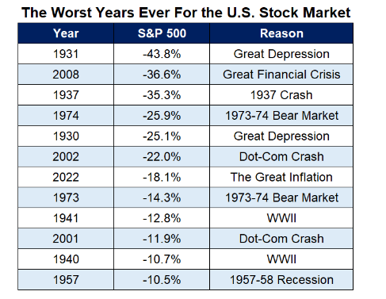
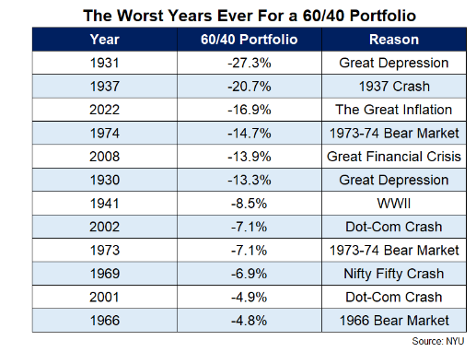
2022 Was One of the Worst Years Ever For Markets
Data Source: A Wealth of Common Sense, As of 1/2/23
Notes:
https://awealthofcommonsense.com/2023/01/2022-was-one-of-the-worst-years-ever-for-markets/

Slide 5
Folly of Forecasts
Data Source: The Big Picture, As of 8/21/23
Notes:
https://ritholtz.com/2023/08/folly-of-forecasts-big-short-edition/

Slide 6
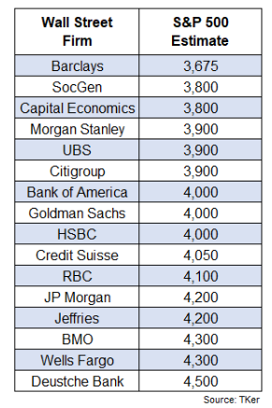
“Price Targets”
Data Source: A Wealth of Common Sense, As of 6/13/23
Notes:
https://awealthofcommonsense.com/2023/06/this-is-why-you-stay-the-course/

Slide 7
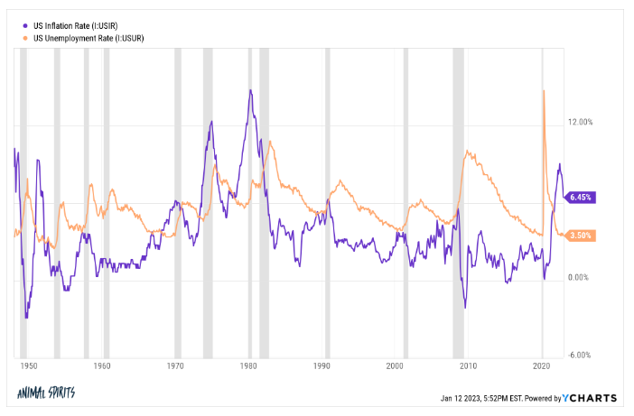
What if We Don’t Get a Recession This Year?
Data Source: A Wealth of Common Sense, As of 1/13/23
Notes:
https://awealthofcommonsense.com/2023/01/what-if-we-dont-get-a-recession-this-year/

Slide 8
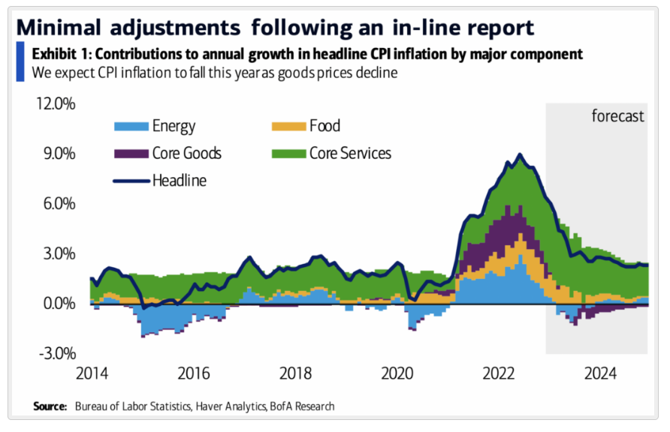
Why Inflation Has Been Falling
Data Source: The Big Picture, As of 1/13/23
Notes:
https://ritholtz.com/2023/01/why-inflation-has-been-falling/#:~:text=CPI%20inflation%20has%20been%20coming,our%20buying%20behaviors%20are%20normalizing.&text=The%20biggest%20inflationary%20issue%20remains,Owners%20Equivalent%20Rent%20(OER).

Slide 9
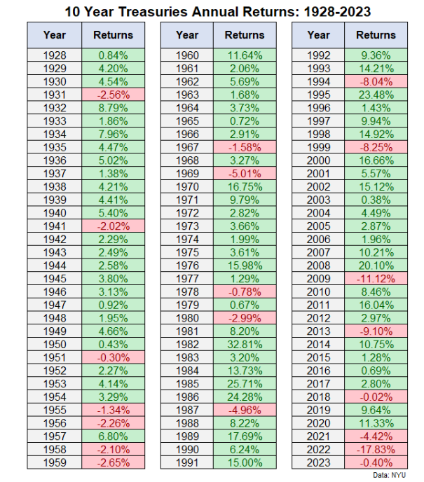
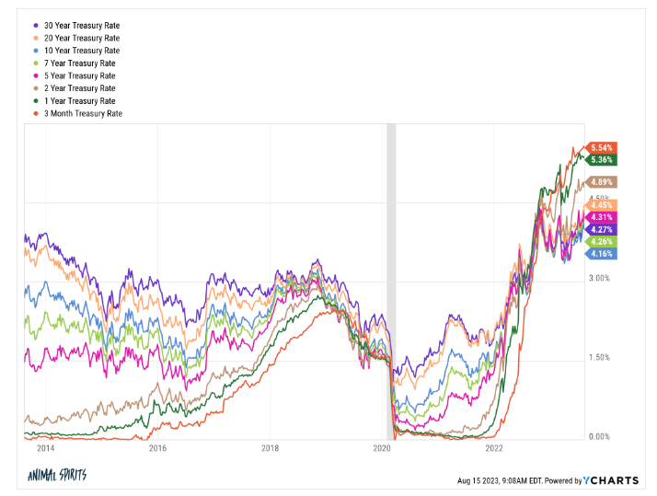
Chaos in Fixed Income
Data Source: A Wealth of Common Sense, As of 8/15/23
Notes:
https://awealthofcommonsense.com/2023/08/why-arent-investors-selling-stocks-to-buy-bonds/

Slide 10
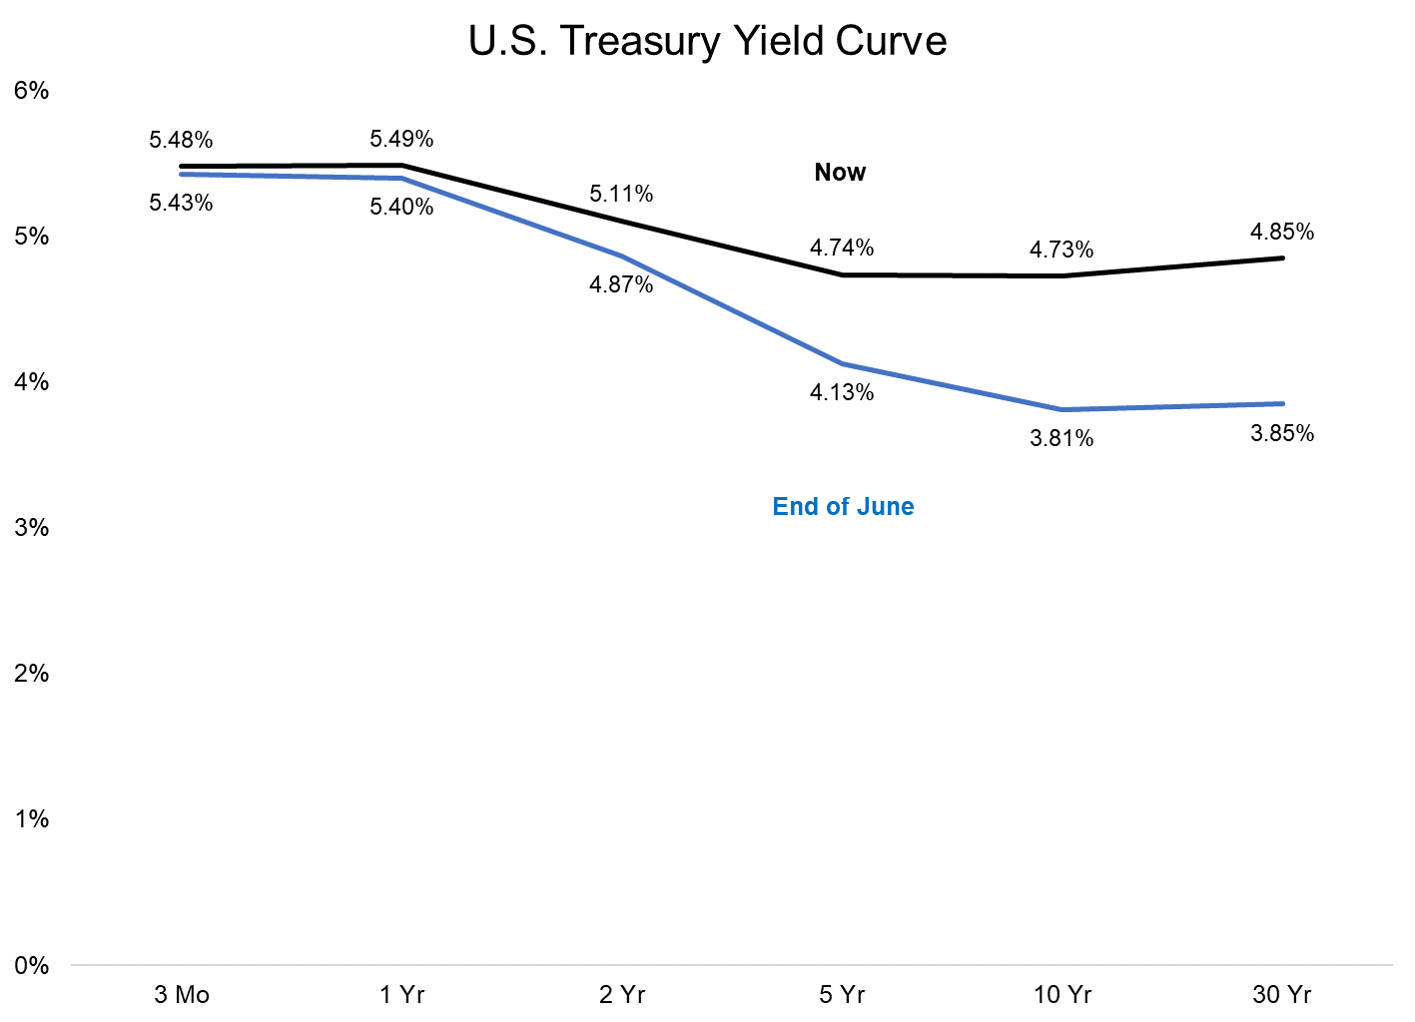
Steepening Yield Curve
Data Source: A Wealth of Common Sense, As of 10/3/23
Notes:
https://awealthofcommonsense.com/2023/09/three-things-investment-people-hate-to-admit/

Slide 11
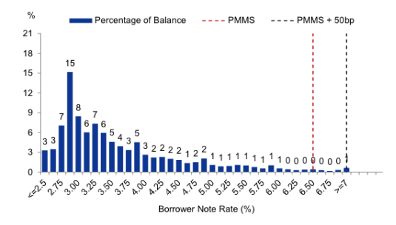
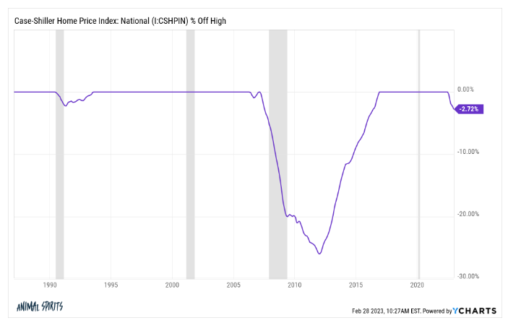
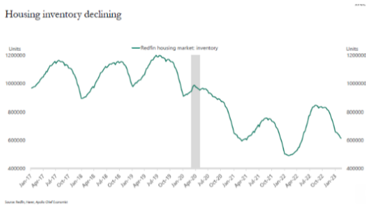
Why Aren’t Housing Prices Crashing?
Data Source: A Wealth of Common Sense, As of 8/6/23
Notes:
https://awealthofcommonsense.com/2023/03/why-arent-housing-prices-crashing/

Slide 12
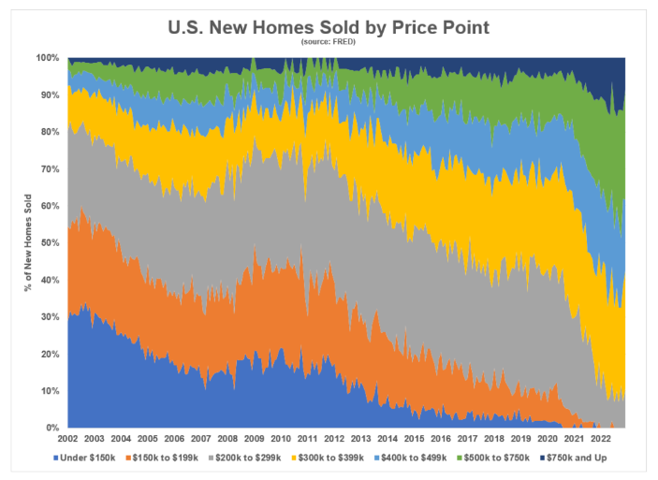
Where Have all the $200k Houses Gone?
Data Source: A Wealth of Common Sense, As of 2/10/23
Notes:
https://awealthofcommonsense.com/2023/02/where-have-all-the-200000-houses-gone/

Slide 13
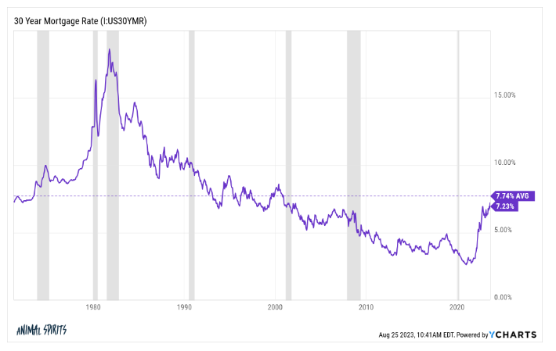
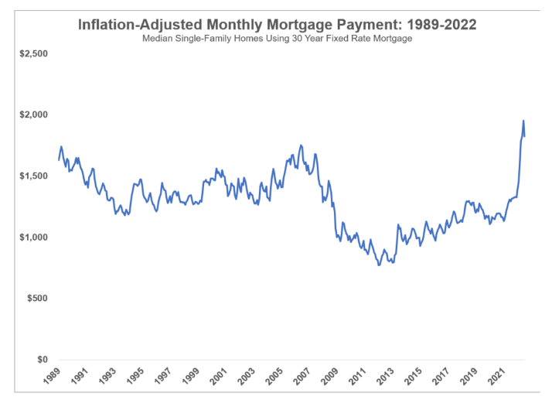
Will We Ever See Affordable Housing Prices Again?
Data Source: A Wealth of Common Sense, As of 8/25/23
Notes:
https://awealthofcommonsense.com/2023/04/will-we-ever-see-affordable-housing-prices/

Slide 14
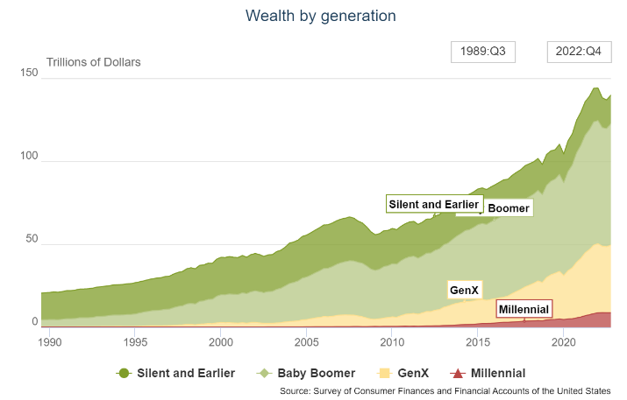
Demographics Matter
Data Source: A Wealth of Common Sense, As of 4/11/23
Notes:
https://awealthofcommonsense.com/2023/04/how-rich-are-the-baby-boomers/

Slide 15
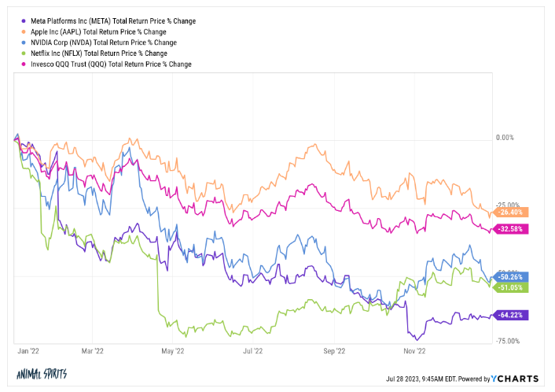
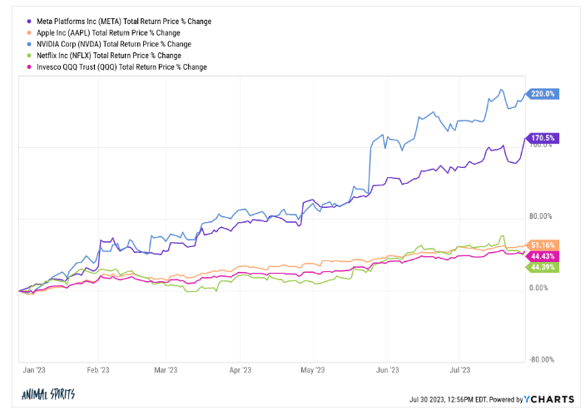
One Year Returns Don’t Matter
Data Source: A Wealth of Common Sense, As of 7/30/23
Notes:
https://awealthofcommonsense.com/2023/07/one-year-returns-dont-matter/

Slide 16
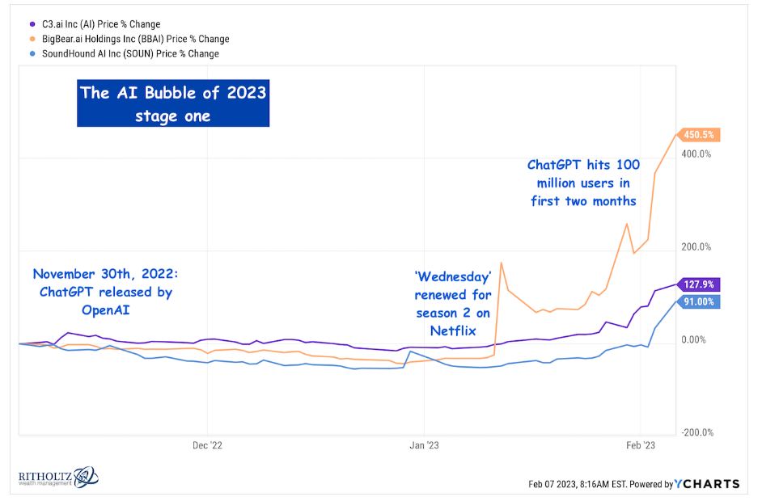
The Ai Bubble of 2023
Data Source: The Reformed Broker, As of 2/7/23
Notes:
https://thereformedbroker.com/2023/02/07/the-ai-bubble-of-2023/

Slide 17
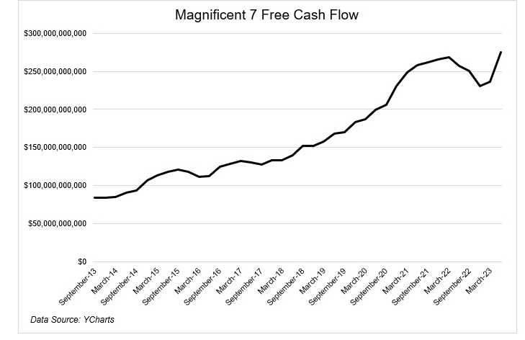
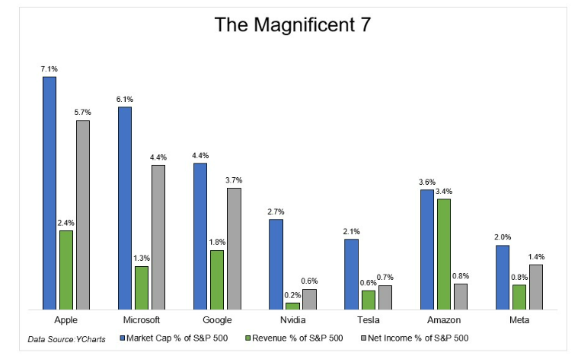
The Magnificent 7
Data Source: The Irrelevant Investor, As of 9/22/23
Notes:
https://theirrelevantinvestor.com/2023/09/22/the-not-so-magnificent-493/

Slide 18
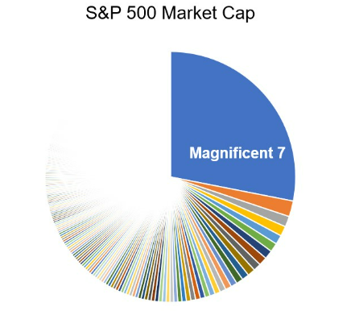
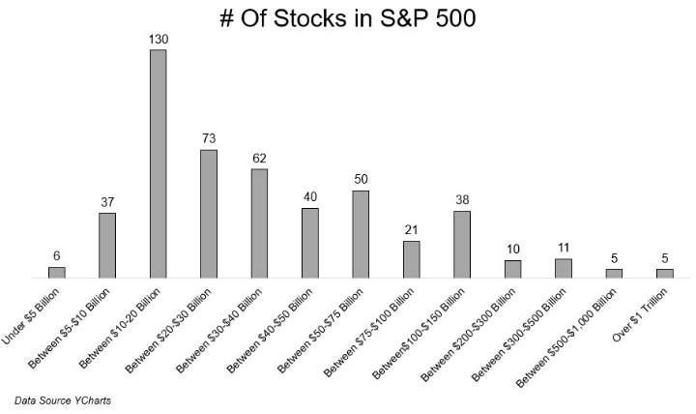
The Not So Magnificent 493
Data Source: The Irrelevant Investor, As of 9/22/23
Notes:
https://theirrelevantinvestor.com/2023/09/22/the-not-so-magnificent-493/

Slide 19
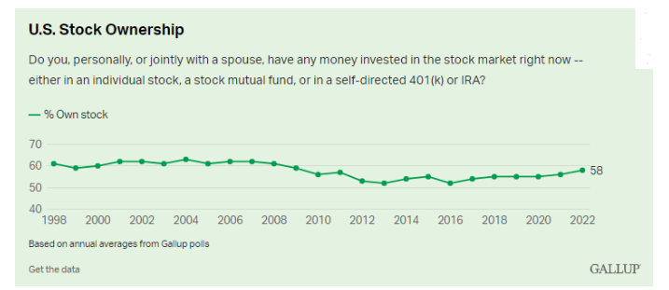
The Relentless Bid Continues
Data Source: A Wealth of Common Sense, As of 5/19/23
Notes:
https://awealthofcommonsense.com/2023/05/whats-the-best-long-term-investment/

Slide 20
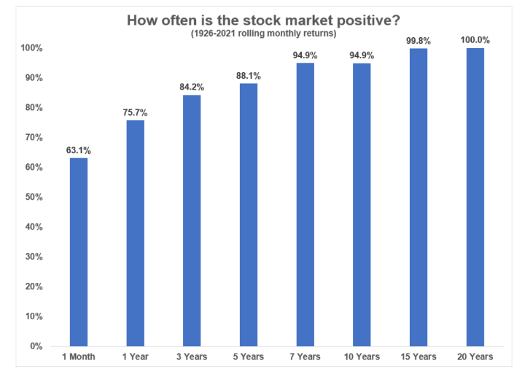
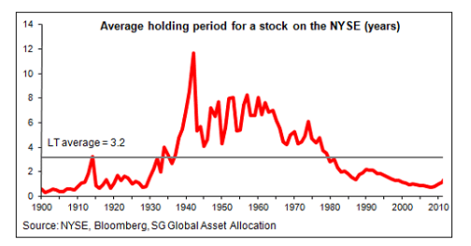
Long Live Buy and Hold
Data Source: A Wealth of Common Sense, As of 2/17/23
Notes:
https://awealthofcommonsense.com/2023/02/buy-hold-is-dead-long-live-buy-hold/

Slide 21
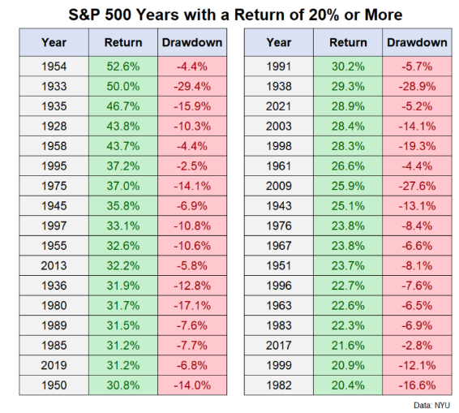
Even When the Stock Market Goes Up, it Still Goes Down
Data Source: A Wealth of Common Sense, As of 8/6/23
Notes:
https://awealthofcommonsense.com/2023/08/even-when-the-stock-market-goes-up-it-still-goes-down/

Slide 22
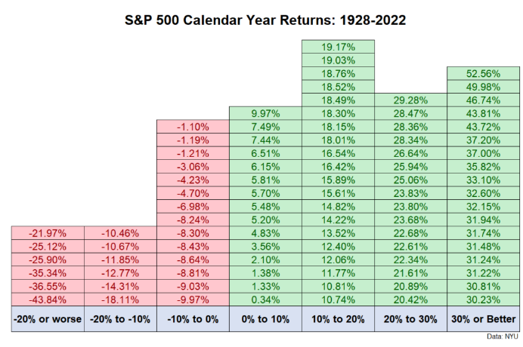
Down Years Are a Feature, Not a Bug
Data Source: A Wealth of Common Sense, As of 1/19/23
Notes:
https://awealthofcommonsense.com/2023/01/is-it-realistic-to-have-100-of-your-portfolio-in-stocks/

Slide 23
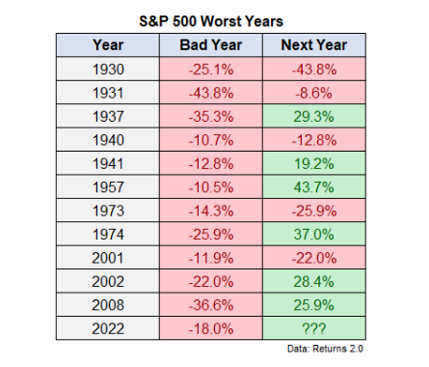
Why We Stay the Course
Data Source: A Wealth of Common Sense, As of 6/13/23
Notes:
https://awealthofcommonsense.com/2023/06/this-is-why-you-stay-the-course/

Slide 24
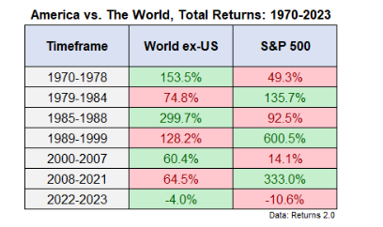
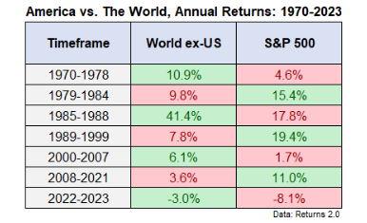
The Case For Diversification
Data Source: A Wealth of Common Sense, As of 5/9/23
Notes:
https://awealthofcommonsense.com/2023/05/the-case-for-international-diversification/

Slide 25
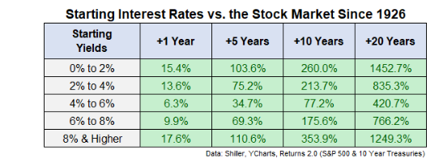
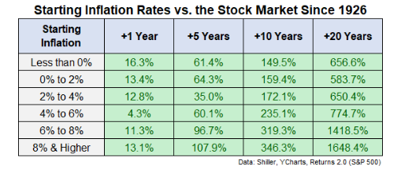
Interest Rates, Inflation and Returns
Data Source: A Wealth of Common Sense, As of 10/3/23
Notes:
https://awealthofcommonsense.com/2023/10/higher-for-longer-vs-the-stock-market/

Slide 26
There Will Always be a Reason to Sell
Data Source: RWM, As of 9/30/23

Slide 27
Ritholtz Wealth Management
24 West 40th Street, 15th floor
New York, NY 10018
212-625-1200
RitholtzWealth.com

Slide 28
Disclaimer
All content and statistics shown within this presentation are believed to be complete and accurate by its creator, Ritholtz Wealth Management. This presentation is for informational purposes only. Nothing contained within should be construed as a solicitation to buy or sell any securities. Investing involves risk and possible loss of principal capital. Investors should consider an investment’s investment objective, risks, charges, and expenses carefully before investing.
Historical returns data for all index products and ETFs provided by Bloomberg L.P. Historical results of “Goaltender” are back tested based on the actual closing prices of the utilized ETFs. An index is a hypothetical portfolio of securities representing a particular market or a segment of it used as indicator of the change in the securities market. Indices are not available for direct investment; therefore, their performance does not reflect the expenses associated with the management of an actual portfolio. The historical results of the “Buy and Hold” model are tested on the “total return” indices, which account for price performance as well as the dividends paid out. A backtest is a tool to present hypothetical results and should not be considered as a performance track record. Past performance is not necessarily indicative of future results. Future performance may markedly differ from previous results. Investing in any model portfolio involves the deduction of advisory fees, mutual fund expense fees, and custodial fees which will impact returns.
This presentation contains confidential information and is intended only for the named recipient. If you are not the named individual you should not disseminate, distribute or copy this presentation. Please notify the sender immediately by e-mail (info@ritholtzwealth.com) if you have received this presentation by mistake and delete it from your system.

